Slide 1
Session 8
Simply Technologies
Lesson Guide
Bitmap to vector conversion
Notes:
Required Materials:
Computers with Vectric Aspire or VCarve Desktop/Pro installed
Sample images (e.g., logos, line art, photographs)
Preferred type: JPG, BMP, SVG, PNG

Slide 2
Learning Objectives
Students will be able to import images in Vectric Software.
Students will be able to use the “Trace Bitmap” tool to convert images into vector files.
Students will be able to clean up and edit traced vectors.

Slide 3
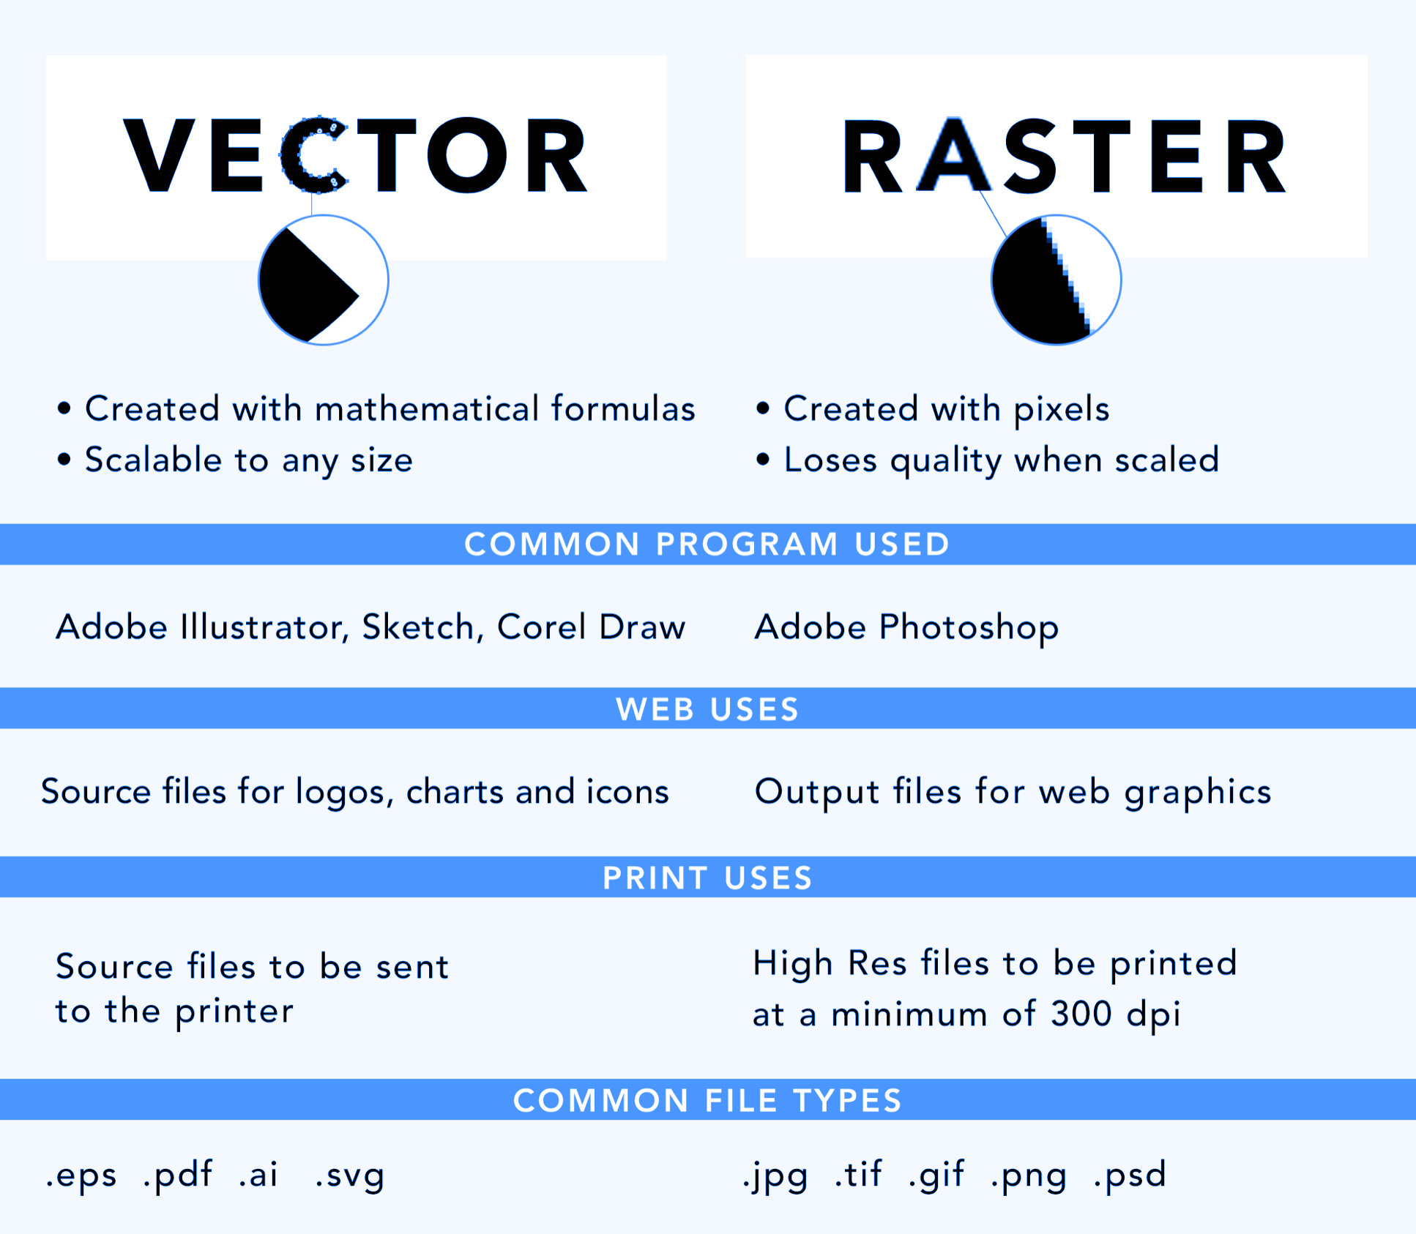
Working With Images
Vector vs. Raster Images
Image Quality Matters
16 or 32 bit
High Contrast
Minimal Colours
Many Shades of One Colour
Beware of Trademarks
Notes:
Introduction (10 minutes)
Briefly introduce Vectric Aspire and its capabilities.
Explain the concept of vector graphics and how they differ from raster images.
Discuss the importance of image quality and resolution for tracing.

Slide 4
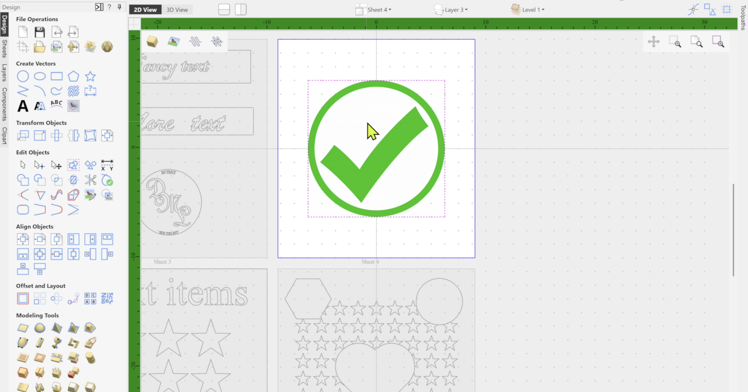
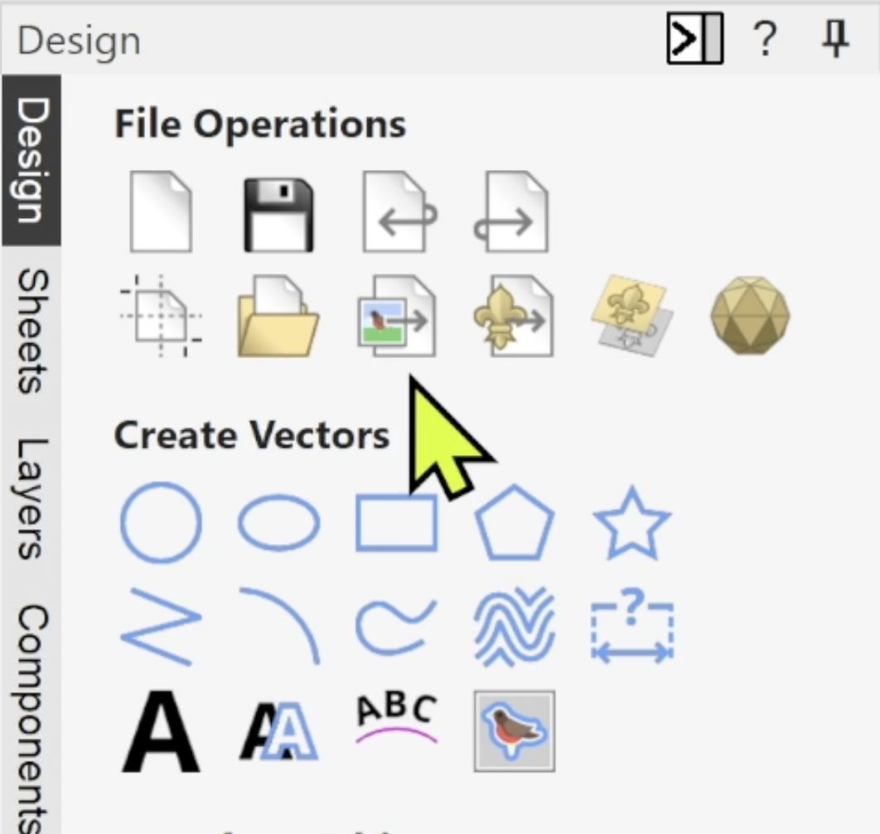
Importing Images
Notes:
Importing Images (15 minutes)
Open Vectric Aspire or VCarve.
Demonstrate how to import an image.
File > Import > Bitmap as well as utilizing the correct icon.
Select the desired image file.
Adjust the image size and position on the workspace.

Slide 5
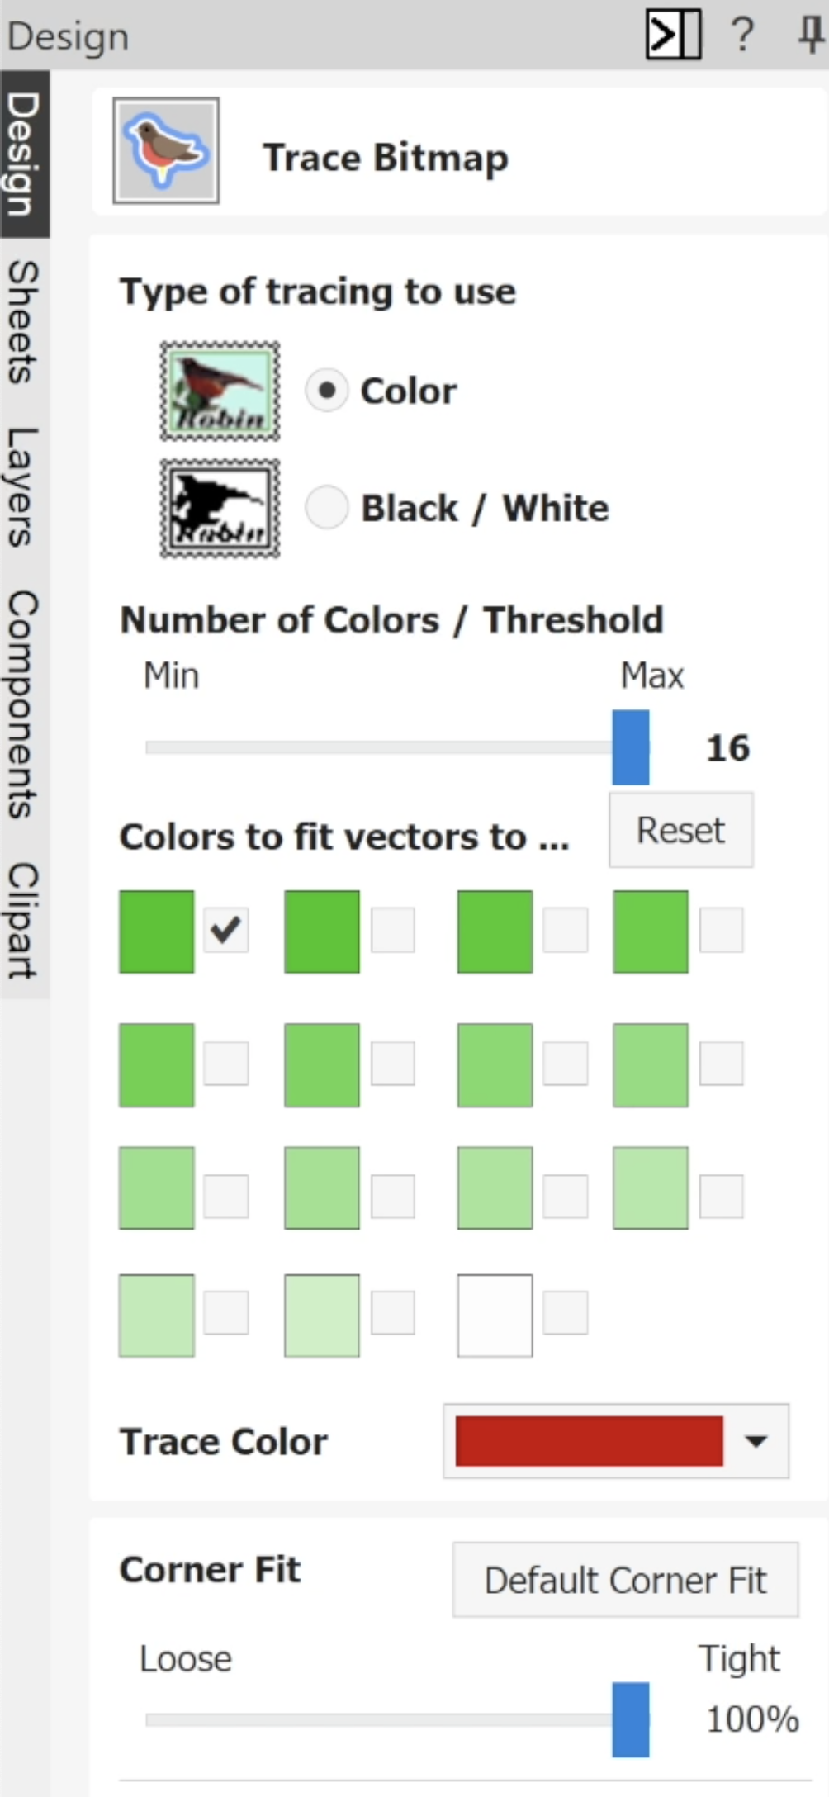
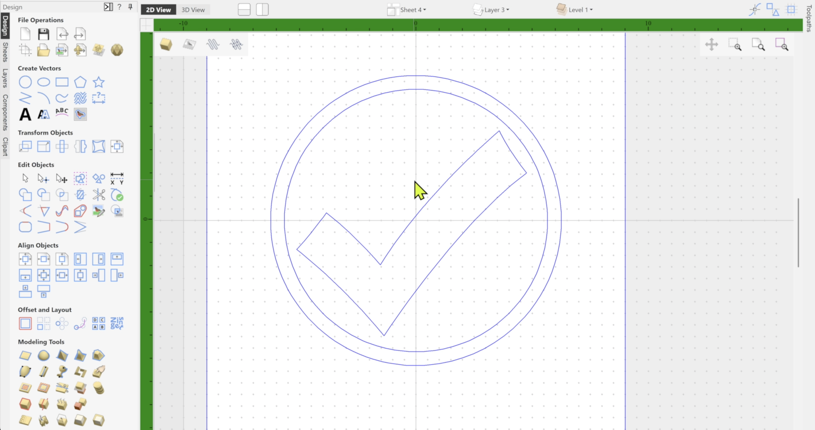
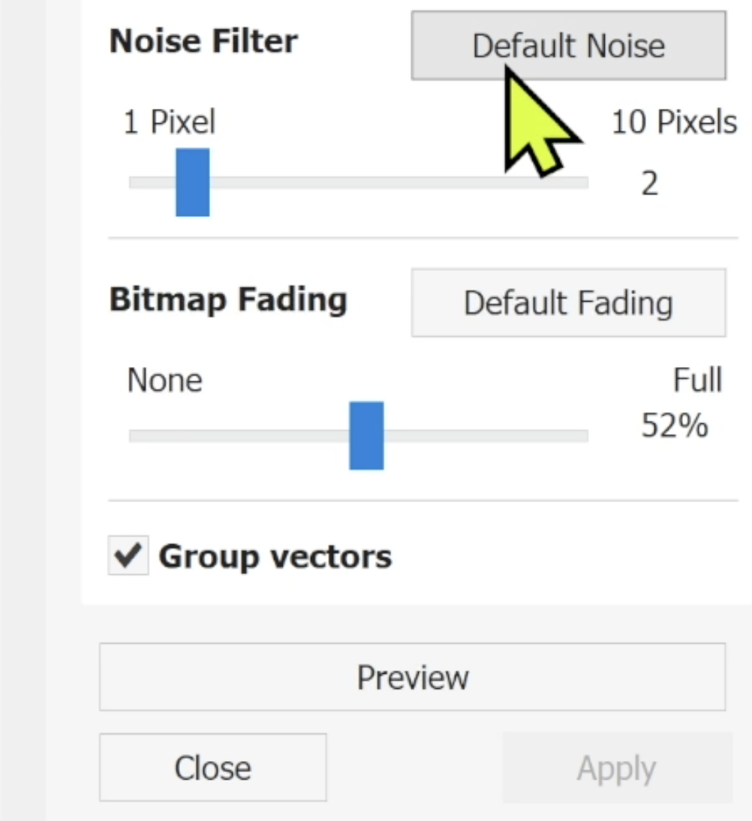
Tracing the Image
Notes:
Tracing Images (20 minutes)
Explain the Trace Bitmap tool.
Access the tool from the Tool Bar.
Adjust the trace settings (threshold, line thickness, etc.) to optimize the tracing process.
Demonstrate how to trace different types of images (line art, photographs, etc.).

Slide 6
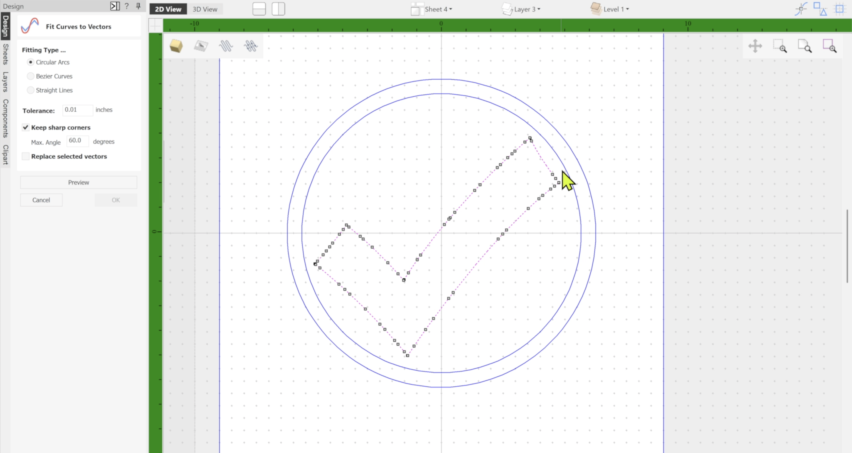
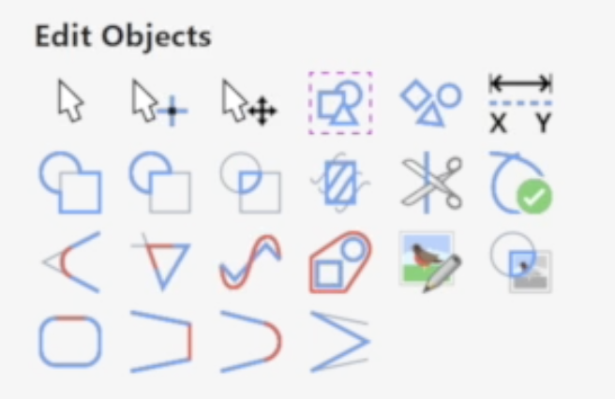
Cleaning Vectors
Notes:
Cleaning Up Traced Vectors (20 minutes)
Explain the importance of cleaning up traced vectors.
Remove unnecessary nodes and lines.
Smooth out rough edges.
Close open paths.
Demonstrate how to use the Node Edit tool to modify vector paths.

Slide 7
Session 8 Summary
Simply Technologies
Lesson Guide
BITMAP TO VECTOR CONVERSION
Notes:
Conclusion (5 minutes)
Review the key concepts covered in the lesson.
Discuss potential applications of Vectric Software in various fields (e.g., woodworking, metalworking, sign making).
Answer any questions from students.
Practice Activity (30 minutes) (Recommended)
Assign students a project, such as creating a custom sign or logo in the design environment.
Provide guidance and assistance as needed.
Encourage students to experiment with different tracing techniques.
Assessment:
Observe students' work during the practice activity.
Evaluate the quality of their traced vectors.
Assess their ability to troubleshoot and solve problems.
Additional Tips:
Provide clear and concise instructions.
Use visual aids (e.g., screencasts, diagrams) to enhance understanding.
Encourage students to ask questions and experiment with different techniques.
Offer additional resources and tutorials for further learning.
By following this lesson plan, students will gain a solid foundation in importing and tracing images in Vectric Aspire/VCarve, preparing them for more advanced CNC projects.

